Slide 1
Online advertising management system
​

Slide 2
AGENDA
Introduction​
Project Overview
​Key features
Technology Stack
​Key Takeaways
Future steps
Resources and References
User Survey

Slide 3
Introduction
An online advertising management system (OAMS) is a software application that helps businesses create, manage, and track their online advertising campaigns. OAMSs typically offer a variety of features, such as:
Ad creation and management: This includes the ability to create and edit ads, set targeting criteria, and track performance.
Campaign management: This includes the ability to create and manage multiple campaigns, set budgets, and track ROI.
Reporting and analytics: This includes the ability to generate reports on campaign performance, such as click-through rate, conversion rate, and cost per click.
Integration with other systems: This includes the ability to integrate with other systems, such as CRM systems and website analytics tools.

Slide 4
Project overview
Project goal: The goal of this project is to develop an OAMS that will help businesses create, manage, and track their online advertising campaigns more efficiently and effectively.
Project scope: The OAMS will cover the following aspects of online advertising:
Ad creation and management
Campaign management
Reporting and analytics
Integration with other systems
Project deliverables: The project deliverables will include the following:
OAMS software application
Documentation for the OAMS software
User training materials for the OAMS software
Project schedule: The project is scheduled to be completed within 6 months.
Project risks: The following are some of the risks associated with this project:
Technical risks: The OAMS software may not be developed on time or within budget.

Slide 5
Key features
Ad creation and management
User-friendliness
Cost-effectiveness
Reporting and analytics

Slide 6
Technology stack
Front End
Html
CSS
Django
Flask
Back End
Python along with Django framework
Database Management
sqlite3 was chosen for database system to handle data relationships
Realtime Functionality
To achieve real-time messaging, I integrated WebSocket technology, ensuring instantaneous communication between users.

Slide 7
Key takeaways
OAMSs can be a valuable tool for businesses of all sizes to improve the efficiency and effectiveness of their online advertising campaigns.
The key features of an OAMS project include ad creation and management, campaign management, reporting and analytics, integration with other systems, security, scalability, user-friendliness, and cost-effectiveness.
Real-time functionality is a key feature of any OAMS project. It allows businesses to monitor and adjust their campaigns in real time, based on the latest data.
The benefits of real-time functionality in an OAMS project include improved campaign performance, increased ROI, better decision-making, and reduced costs.

Slide 8
Future steps
Continue to develop and improve the system.
Expand the reach of the system.
Partner with other businesses.
Expand into new markets.
Develop new marketing strategies.

Slide 9
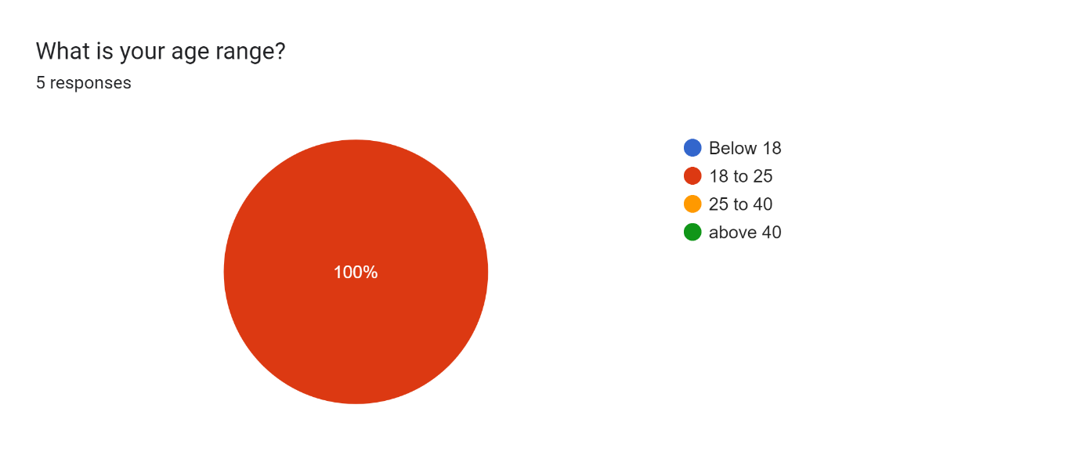
User survey

Slide 10

Team members
M Sai KISHORE
A. Sri vishal
P. Siva Sathvik
Team Leader
Team Member
Team Member

Slide 11
THANK YOU

